Slide 1
Prakrati
Data Analytics
Team Name - WAKANDA_FOR3V3R
Ayush Kumar 9661179290 17CS10007 IIT KHARAGPUR
Anshul Choudhary 8918500798 17CS10005 IIT KHARAGPUR
Prakhar Bindal 9593801201 17CS10036 IIT KHARAGPUR
Shubham Raj 9733331647 17CE10054 IIT KHARAGPUR

Slide 2

Overview
Plants require many mineral elements for their nutrition. These include the macronutrients nitrogen (N), potassium (K), calcium (Ca), magnesium (Mg), carbon (C) and sulphur (S) and the micronutrients iron (Fe), manganese (Mn), zinc (Zn), nickel (Ni), titanium(Ti), rubidium(Rb), silicon(Si) and strontium(Sr). Plant health highly depends upon the availability of these nutrients in the soil that can be estimated through several advanced techniques such as spectrometry, spectroradiometer, and PXRF(Portable X-ray Fluorescence) spectroscopy etc.

Slide 3


GOAL
To determine the Total Nitrogen and Total Carbon percentage using spectral data and elemental data of soil samples
To determine Influential variables among given data
Find model that fits the data best in terms of RMSE score and accuracy

Slide 4

Methods
Machine learning models are determined using the following steps :
Data Cleaning
Feature Engineering
Data Splitting - Training and Testing data
Model Training on the training data
Model testing, accuracy and RMSE determination
Evaluation

Slide 5
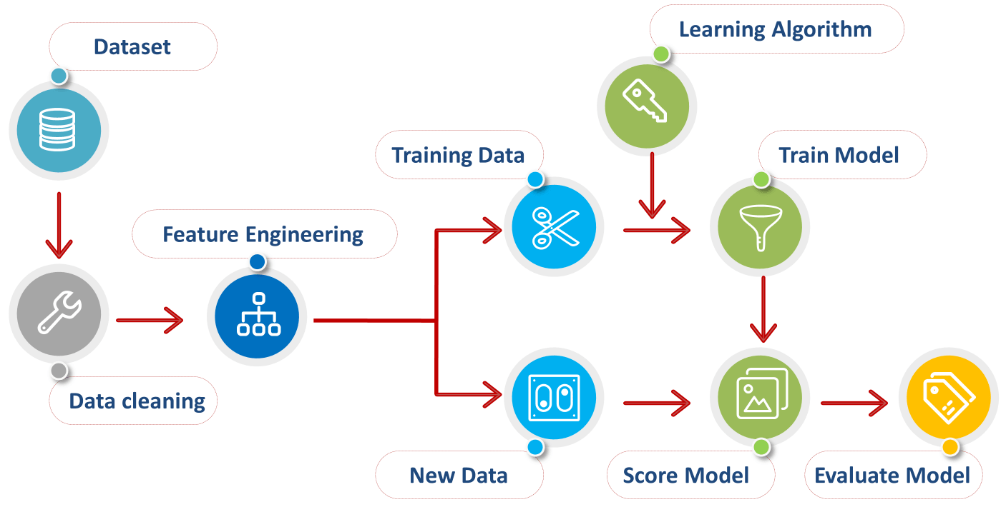

Slide 6

Data Cleaning
The data given contains data of TC(%) and TN(%) as n.d. and 0, as well as certain spectral values are missing. These data examples need to be taken out of consideration while we train and test the model.
Feature Engineering
Data is so sparse, having a lot of features. So first, we did Normalization and then extracted the influential features, who contributed more to the data set using random forest as base model.

Slide 7
Data Splitting
The data is split into training and testing data set as 80% of data is chosen randomly to be the training data and the rest is testing data.
Model Training
Since the number of training examples are very low compared to number of features. We avoid using Deep neural networks. We used different Machine Learning Algorithms like Random Forest, XGBoost, Support Vector Machine to predict the Total Carbon and Total Nitrogen from Elemental, Spectral and combined features. Random Forest Regressor gives promising results with a number of trees equal to 500.

Slide 8
Results
vs | Spectral Data | Elemental Data | Combined Data
TC(%) | 93.787 | 91.157 | 93.824
TN(%) | 75.496 | 51.373 | 77.376
Accuracy
vs | Spectral Data | Elemental Data | Combined Data
TC(%) | 1.634 | 1.949 | 1.629
TN(%) | 0.169 | 0.239 | 0.163
RMSE Score

Slide 9
Results
No. of influential variables
vs | Spectral Data (out of 2149) | Elemental Data (out of 11) | Combined Data (out of 2160)
TC(%) | 135 | 3 | 97
TN(%) | 356 | 3 | 325

Slide 10
Thank You

